Slide 1

A validation of decentralized federated learning for clinical computer vision
Jordan Matelsky
Felipe Parodi
“Fed Heads”

Slide 2
How do you train ML for medical data?
Notes:
The question here is not a technical one; it is a LOGISTICAL one!

Slide 3
How do you train ML for medical data?
Compiling a large dataset in one place is ideal, but logistically hard.
Training a different model at each site is easy, but yields low-quality results.
Notes:
(True of many domains where privacy or security is a consideration)
But we’ve covered already an instance in which we train many models and combine them: ensemble learning! We didn’t apply it to neural networks, but when you do, it’s called…

Slide 4
Federated learning is an ensemble approach for disparate datasets
Notes:
Federated learning.

Slide 5
Federated learning is an ensemble approach for disparate datasets
But what if the brown node drops out?

Slide 6
Our solution: Decentralized federated learning allows for arbitrary network topologies

Slide 7
Our solution: Decentralized federated learning allows for arbitrary network topologies

Slide 8
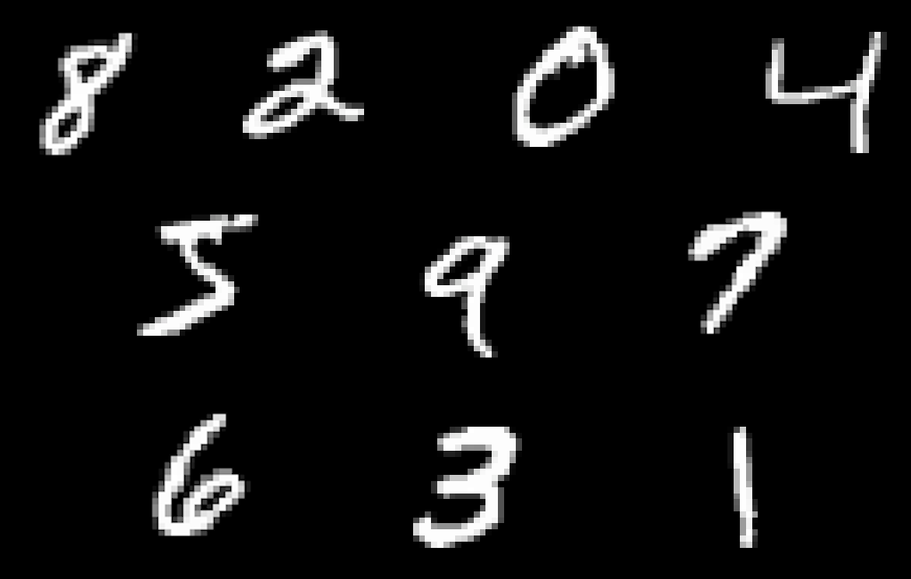
Does decentralized federated learning change learning behavior?

Slide 9
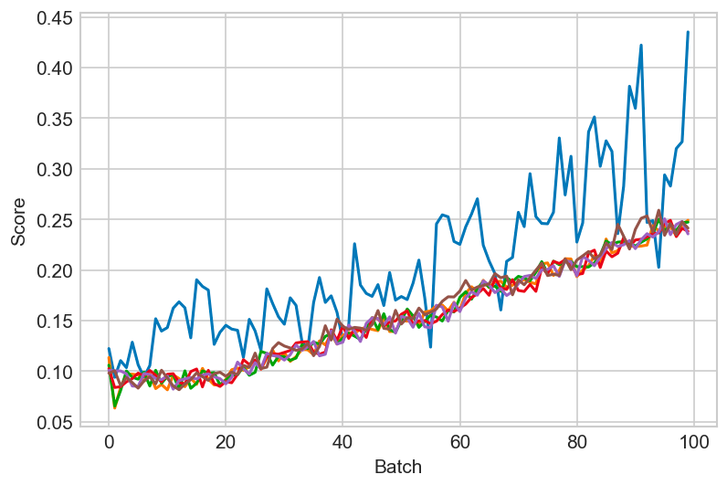
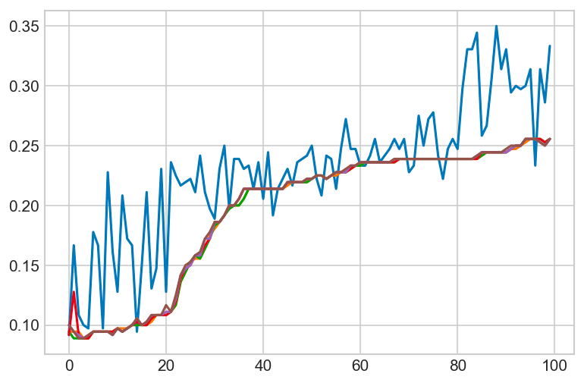
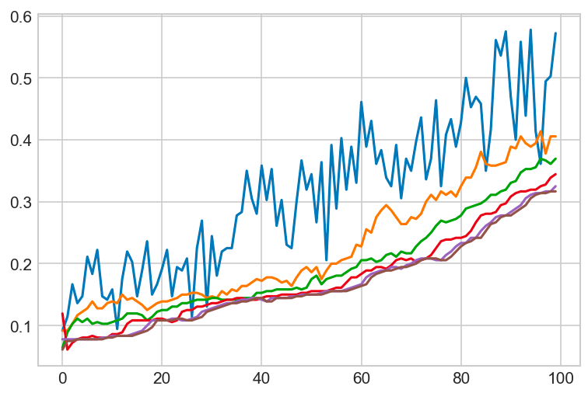
Does decentralized federated learning change learning behavior?

Slide 10
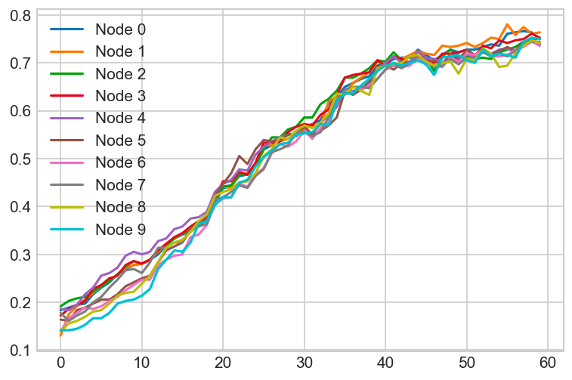
Does decentralized federated learning change learning behavior?

Slide 11
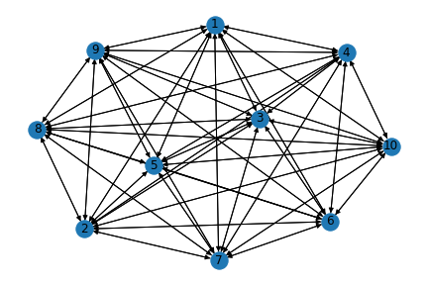
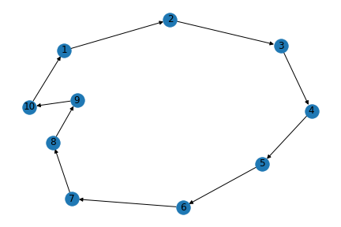
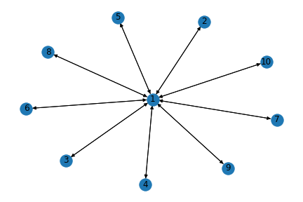
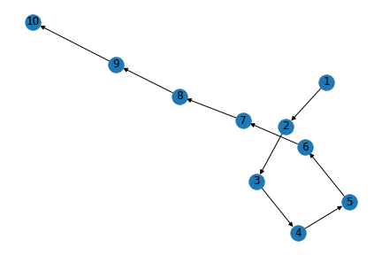
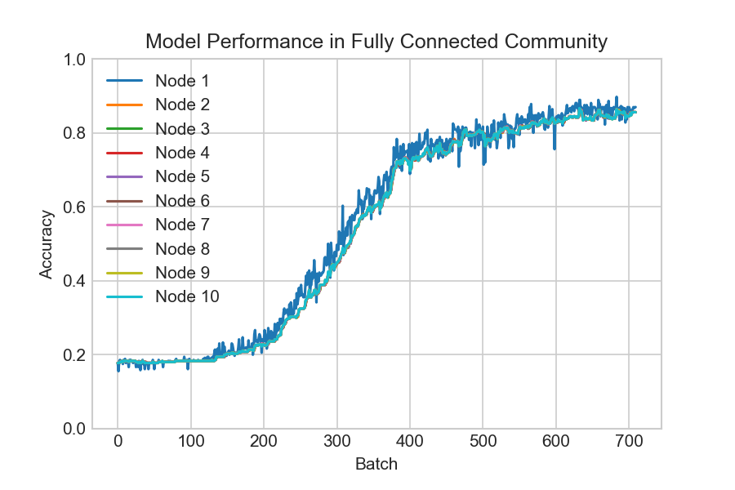
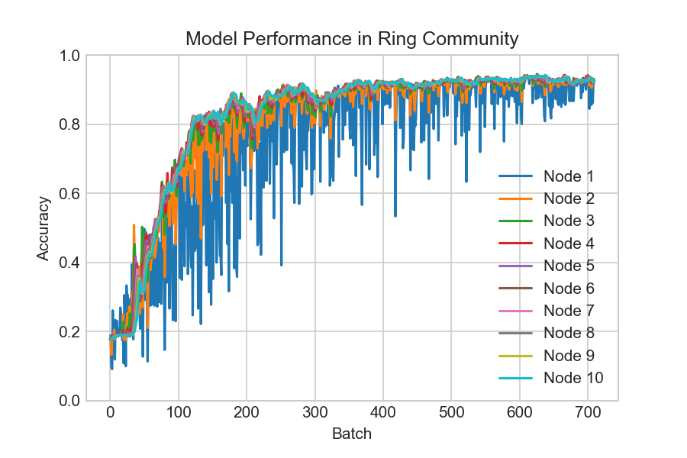
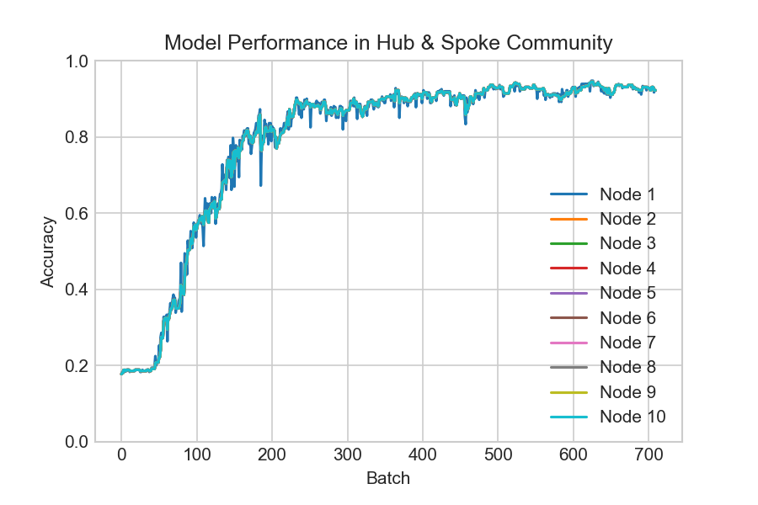
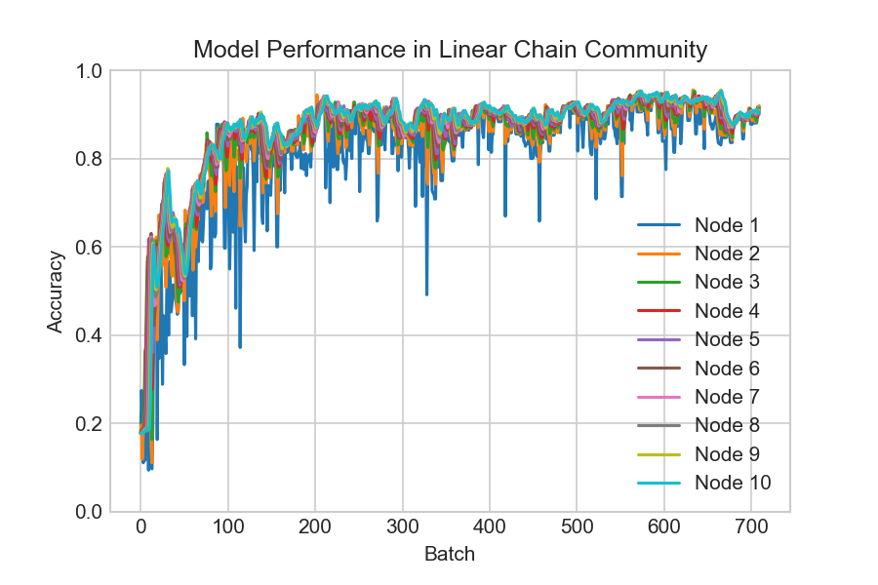
Decentralized federated learning allows for infinitely many topologies
0.869
0.931
0.922
0.916

Slide 12
Thank you!
Jordan Matelsky
Felipe Parodi
github.com/KordingLab/Decentralized-Federated-Learning
Notes:
All of our work here is online, shared as open-source and reproducible Jupyter Notebooks on GitHub. With a single click at the link here, you can jump into a live notebook and start to explore our analysis, or bring your own. We’re actively looking for datasets that coregister lineage information with connectome graphs, and we’re excited to collaborate, so please do reach out!
I’m looking forward to hearing your comments and questions! Thank you.

